Slide 1

MONDO NEWS
Your visual global news platform
Anna Deniz, Benedikt Ströbl, Victor Möslein, Reed Garvin
Progress Report: Data Structures & Algorithms,
29 November 2021
Link:

Slide 2








Mondo News delivers top news from local outlets at a glance on a beautiful and interactive world map
Delivering top headlines without filter bubble
Most popular news articles per country on world map
Most popular headlines per country selected and shown
G20 member states, with easy option to add more countries
5
Top 5 headlines per country from the last 24 hours
Translation of local languages to English
Interactive world map with highlighting of countries
News articles from all categories
Support for nine languages
Beautiful user interface
Search Bar to look for keywords in news
Filter functionality to select news topics of choice
Support for local news outlets of all countries
On world map level
On world map level
Unprecedented access

Slide 3




The Model-View-Controller design philosophy
folium
Updates
Model
View
Manipulates
User Action
Controller
Backend
Frontend
API for searching and retrieving live articles from all over the web
AI service for real-time text and document translation
Analyze geospatial data and create interactive maps
Open-source data analysis and manipulation tool

Slide 4

The A-Team behind Mondo News
Benedikt
Victor
Data, data , dataaaa
Somebody needs to translate the articles!! And who takes care of the updating?!?
Anna
Reed
Well nice code, but where’s that docs?
Make it nice and pretty, PLEASE!

Slide 5
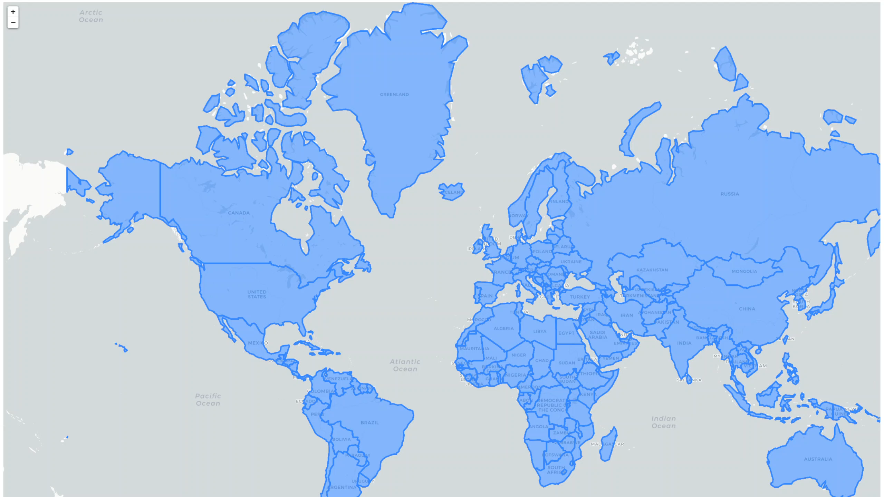

Slide 6
Thank you!
Anna Deniz, Benedikt Ströbl, Victor Möslein, Reed Garvin
Link to our project on GitHub:
Progress Report: Data Structures & Algorithms, 29 November 2021

